Slide 1

STUDENT EXPENSE TRACKER WEBSITE
Presented by
Panchal Ujwal Dasharath (23102020)
Pawar Sahil Sanjay (23102156)
Oswal Sahil Manoj (23102057)
under the guidance of
Prof.P.M.LOHOT

Slide 2

SpendWise
Problem Statement:
The "SpendWise" website is designed to help students track their daily expenses and income. It provides a convenient and efficient way to manage their finances, reducing the stress and anxiety associated with managing expenses. The website functions as a digital diary, recording expenses and alerting users when they exceed their daily limit. This helps students avoid overspending and maintain a balanced budget. If a user spends less than their daily limit, the remaining money is added to their savings. The project aims to create a smoother and more efficient way for students to manage their finances and focus on their careers.

Slide 3



Features
Multiple Accounts
Add Expenses
Add Category
Filter Transaction View
Results

Slide 4
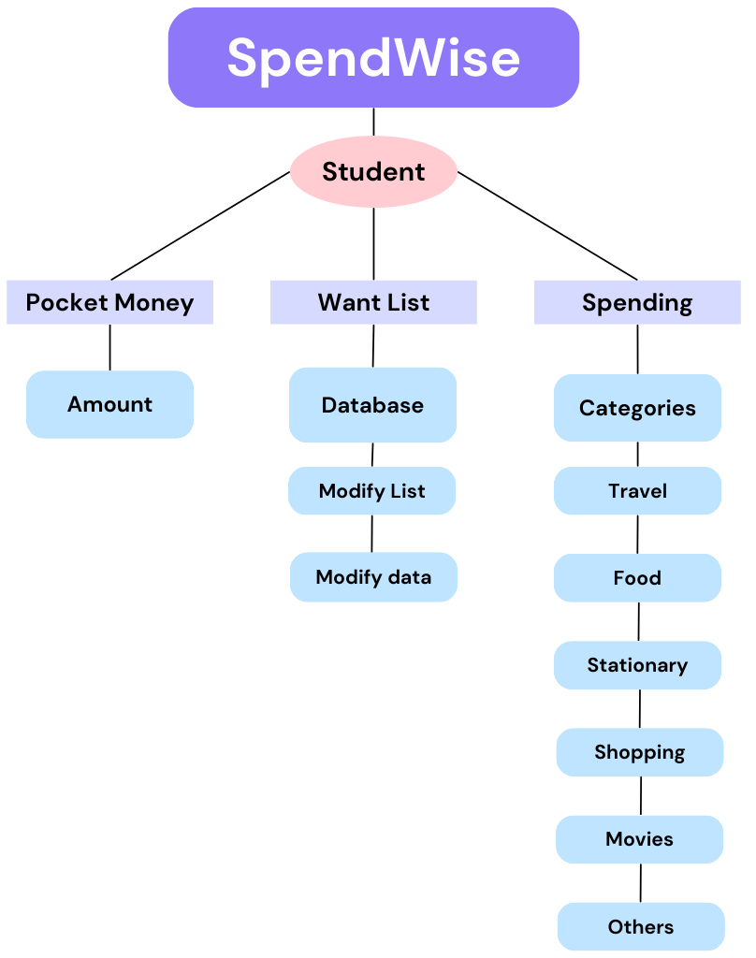
Site Map

Slide 5

Objective Review
Basic Conceptualization: Achieved – Core concept defined for tracking student expenses.
Course Completion: Completed
Design: In Progress – Initial wireframes and mockups created, final website approval pending.
Frontend Development: Completed – Core screens (login, dashboard, expense input)
Backend Integration: Started – next step involves connecting frontend with backend.
Testing: Pending – frontend testing is done. Backend testing is pending.

Slide 6

Work Completion Status
Project Planning: Completed. Objectives and scope defined.
Design Phase: Completed. User interface layout and features are designed.
Front-end Development: Completed Basic structure and UI components are being implemented core screens like login page.
Back-end Development: Started Database setup and server-side logic still pending.
Integration: Not started. Will begin once front-end and back-end development are complete.
Overall, the project is in the early development phase, with design and initial back-end work underway.

Slide 7



Certification
The certification course related to Android Development has been selected, and enrollment is completed. The course has been completed by each member of the group, overing the basics of Android Studio & website development. The certificate of all members is listed below.

Slide 8

Pending Work
Profit/Loss Status: In progress. A dashboard page giving about the profit & loss of the students for a month or a week.
Final Testing and Deployment: Final testing, optimize performance, and prepare for website deployment on the Browser.

Slide 9
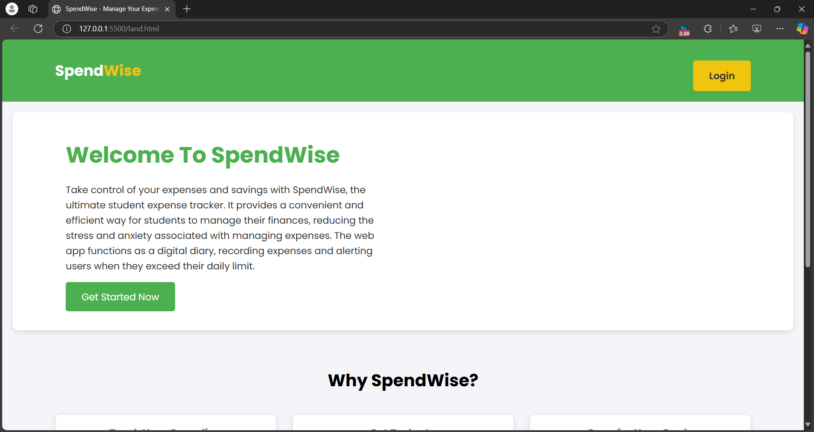
SpendWise Overview
Landing Page:

Slide 10
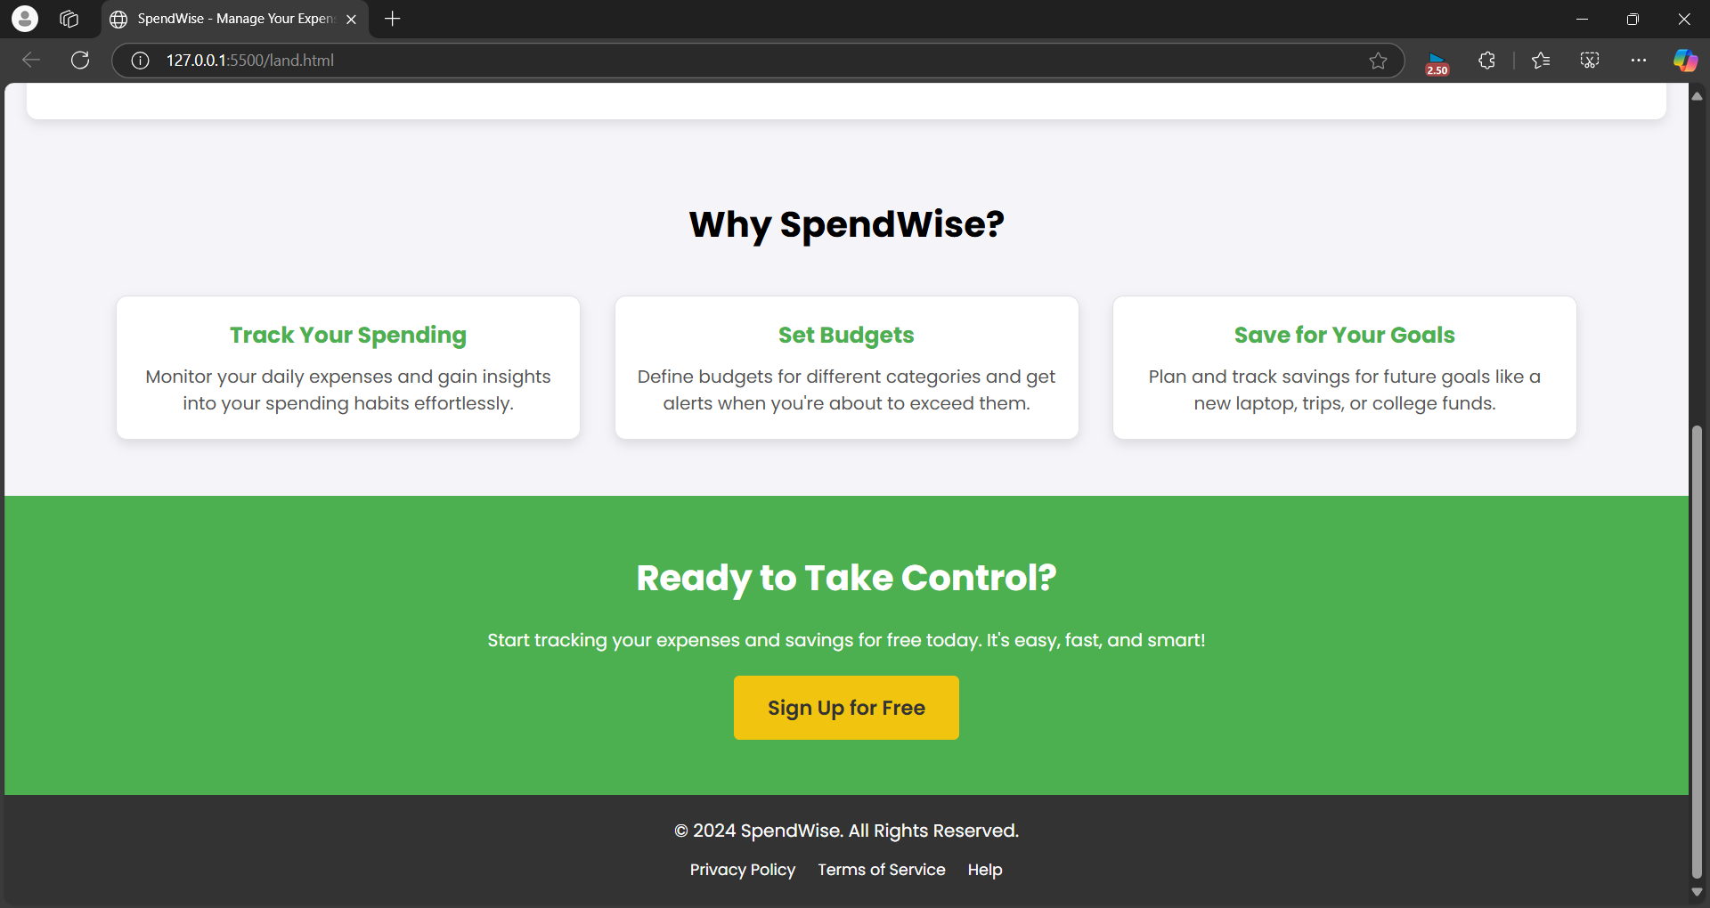

Slide 11
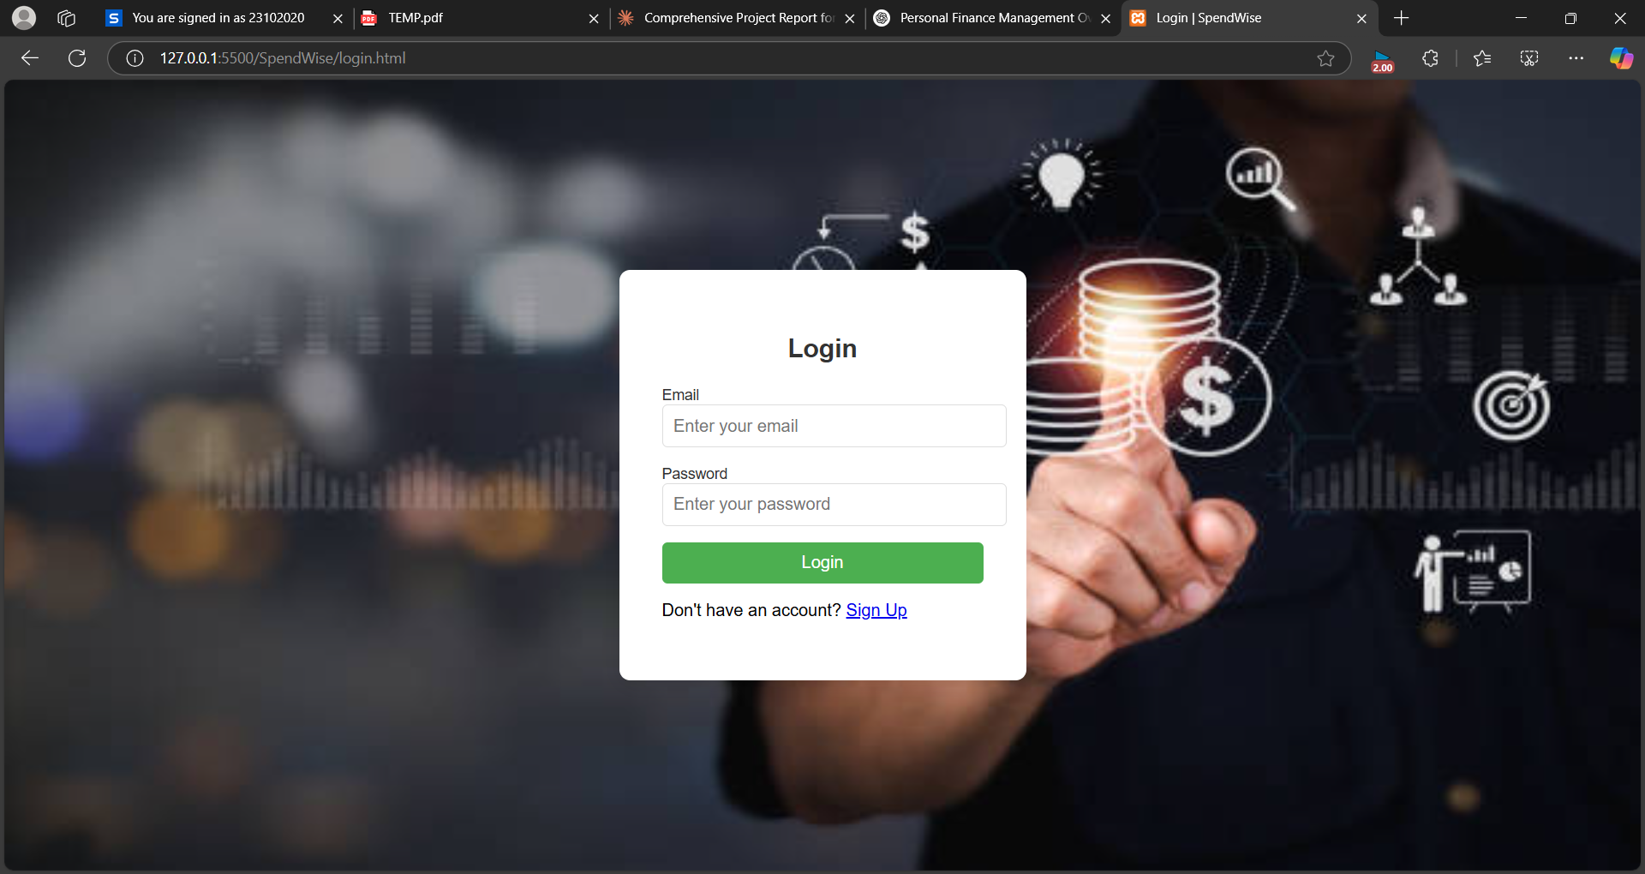

Login/SignUp Page:

Slide 12
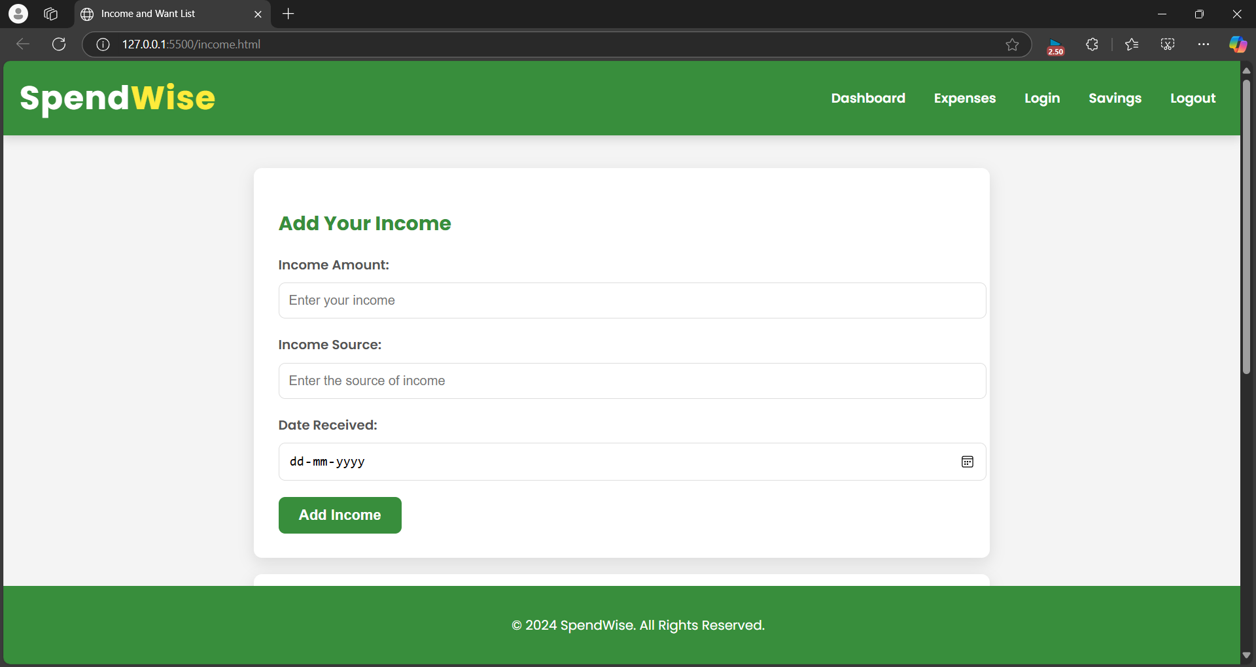
Income / Want list Page:

Slide 13
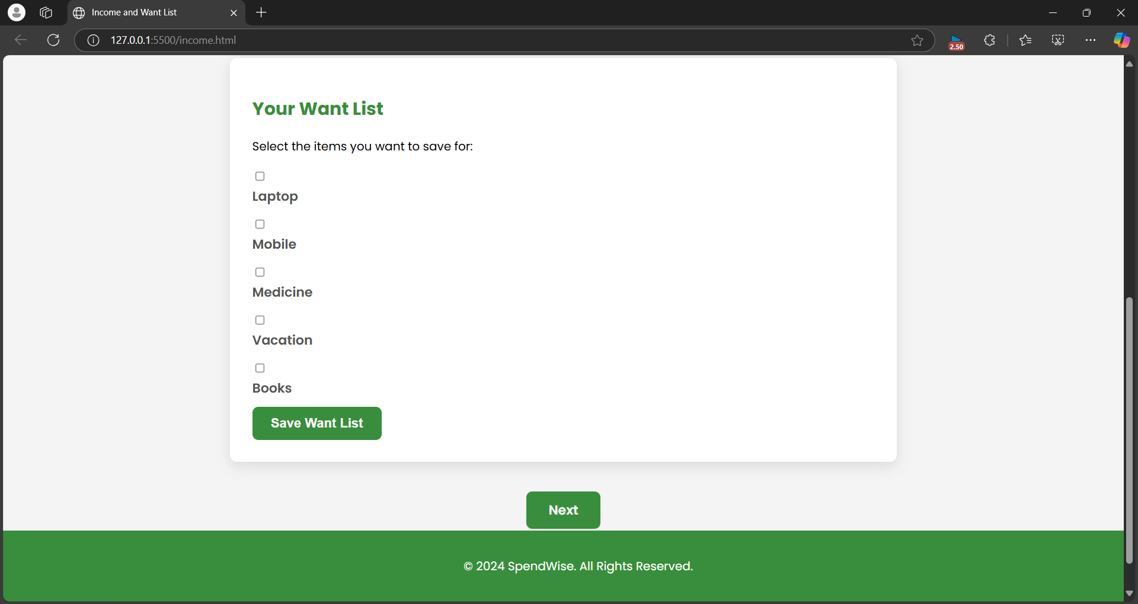

Slide 14
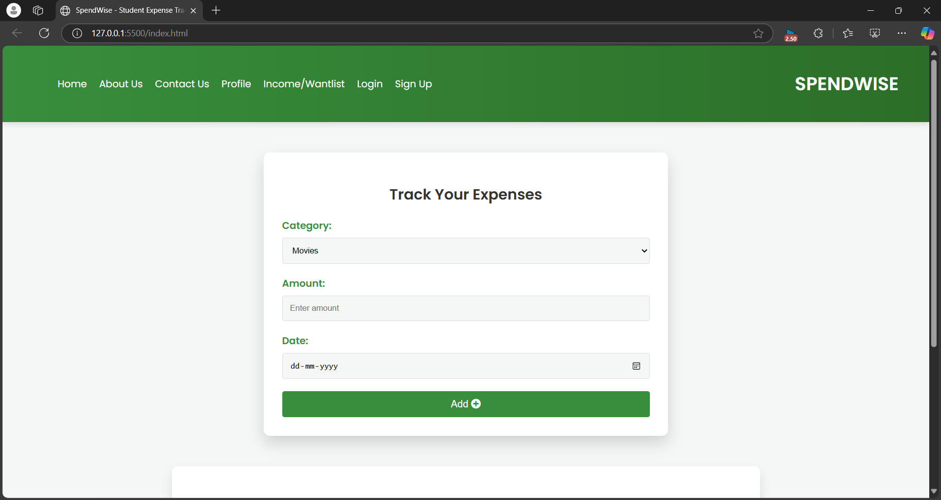
Expenses Page:

Slide 15
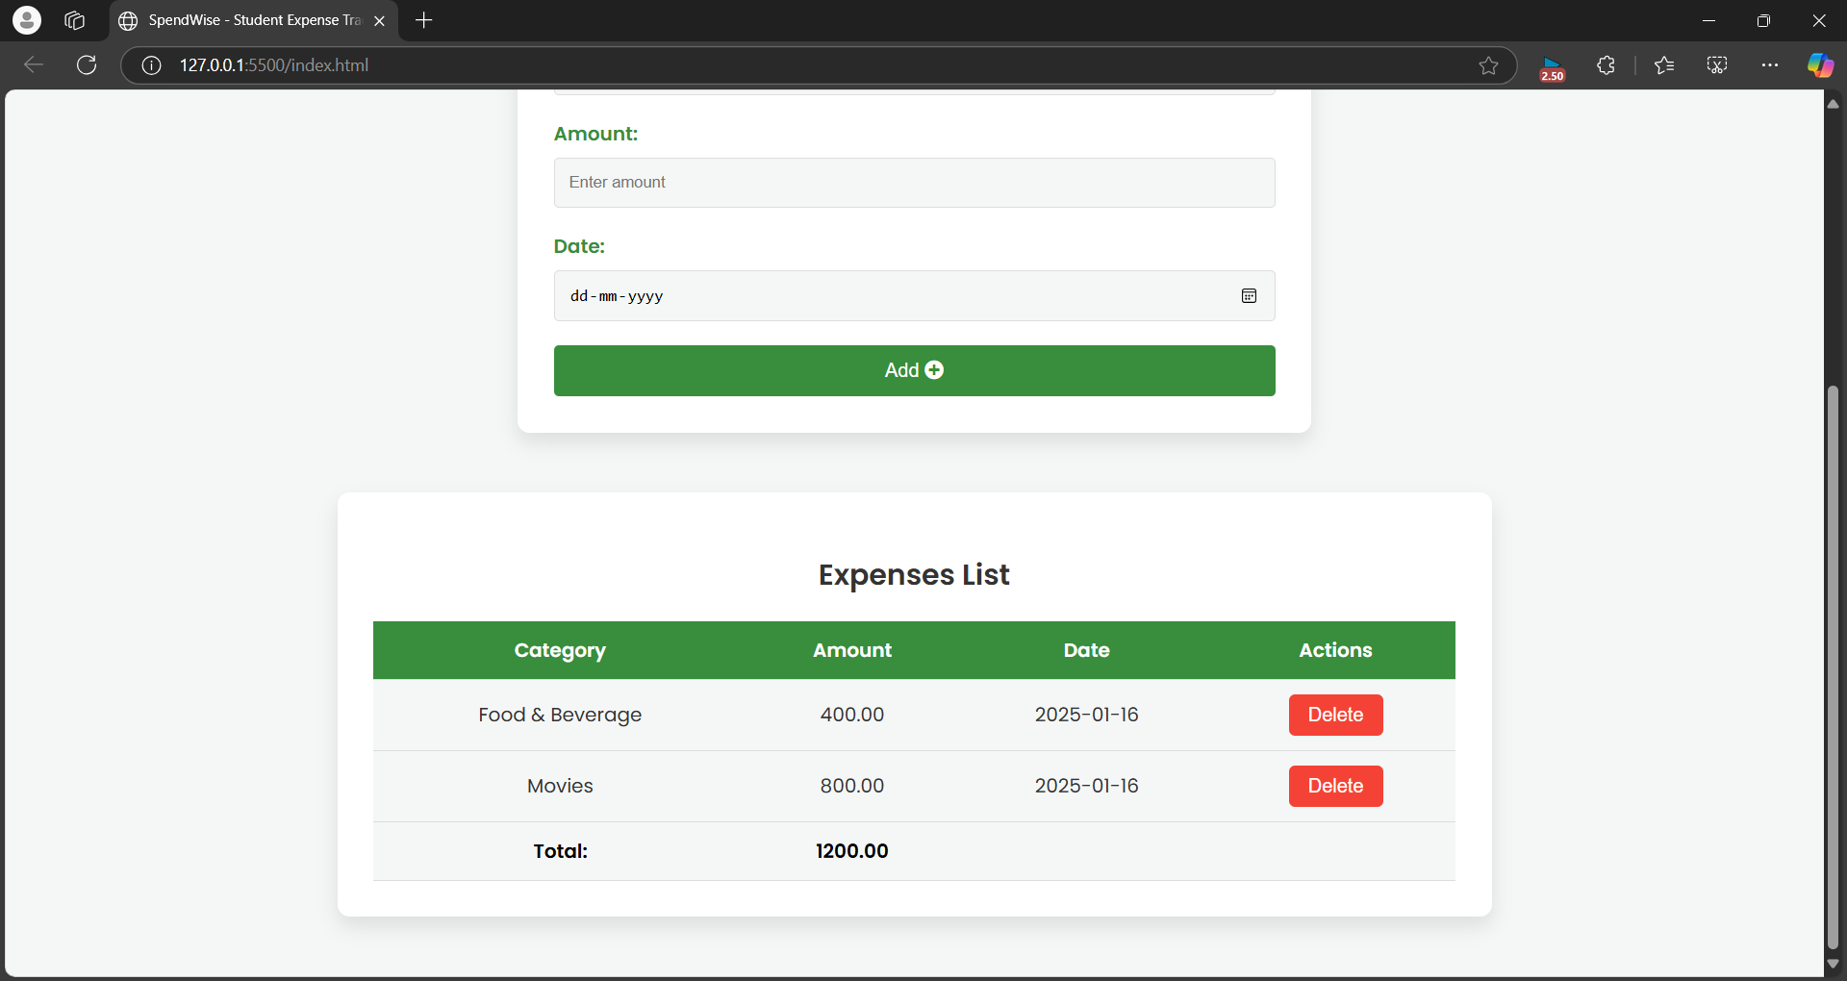

Slide 16
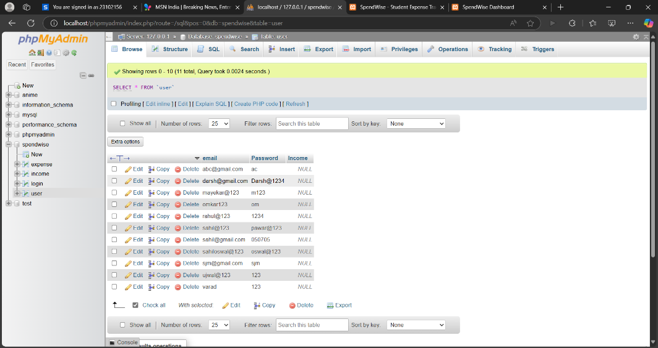
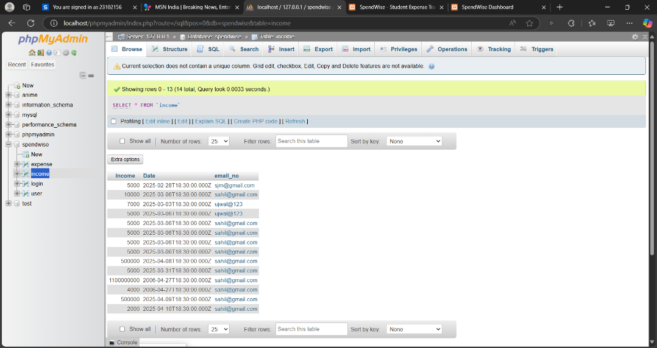
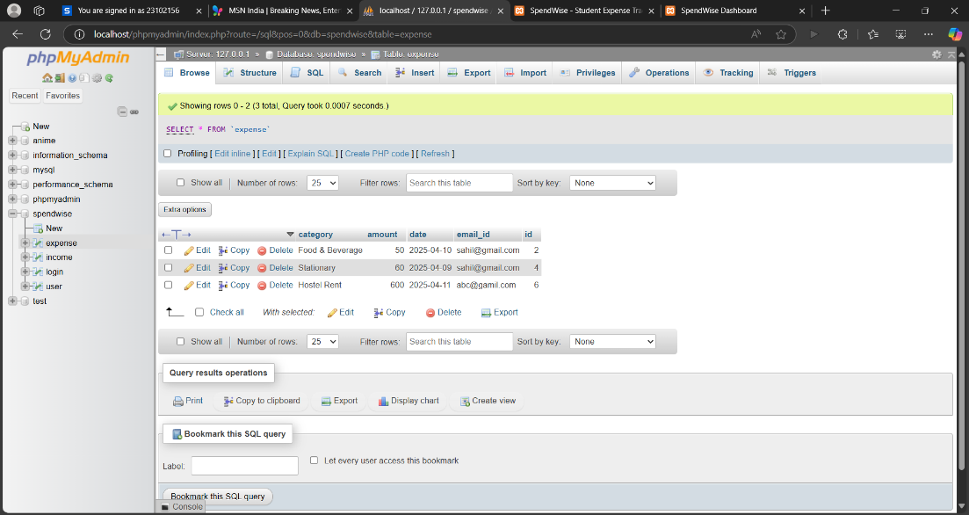

Slide 17
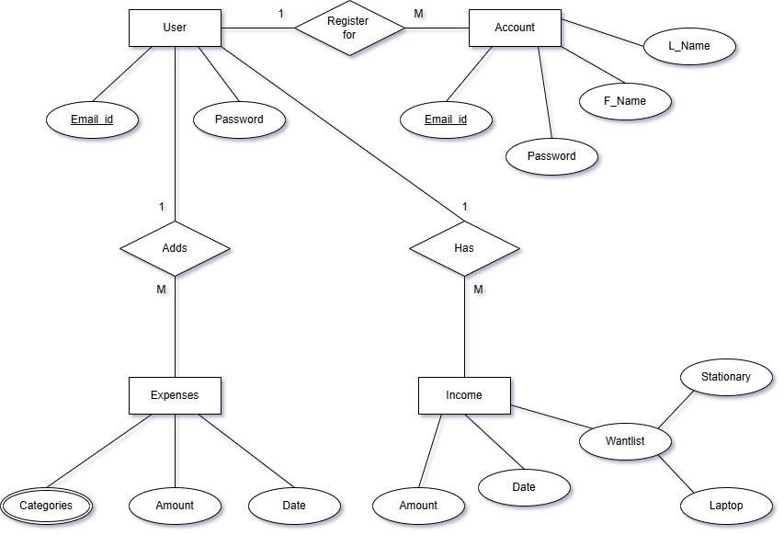

Slide 18
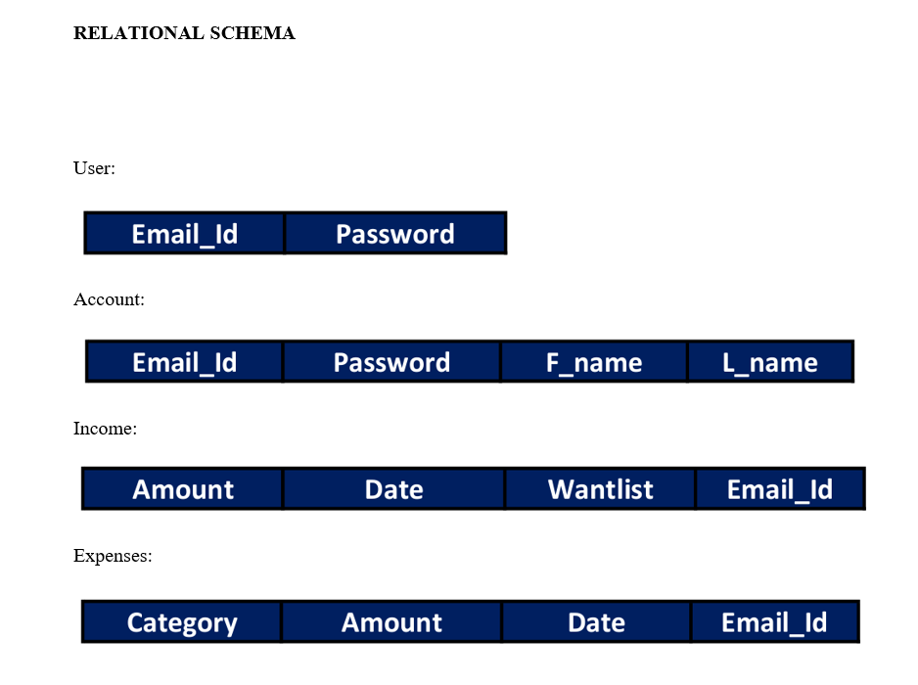

Slide 19
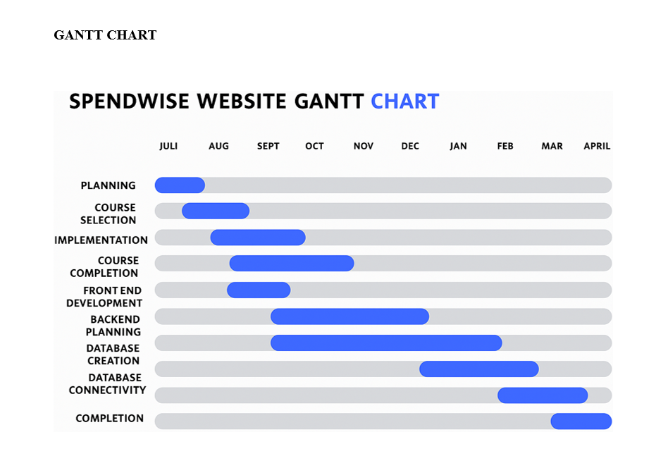

Slide 20
Thank You

